Slide 1
Winner-loser gap in 2021 Canadian federal election ​
Tie Ma & Robert Ta-Chuan Yu
March 03, 2025

Slide 2
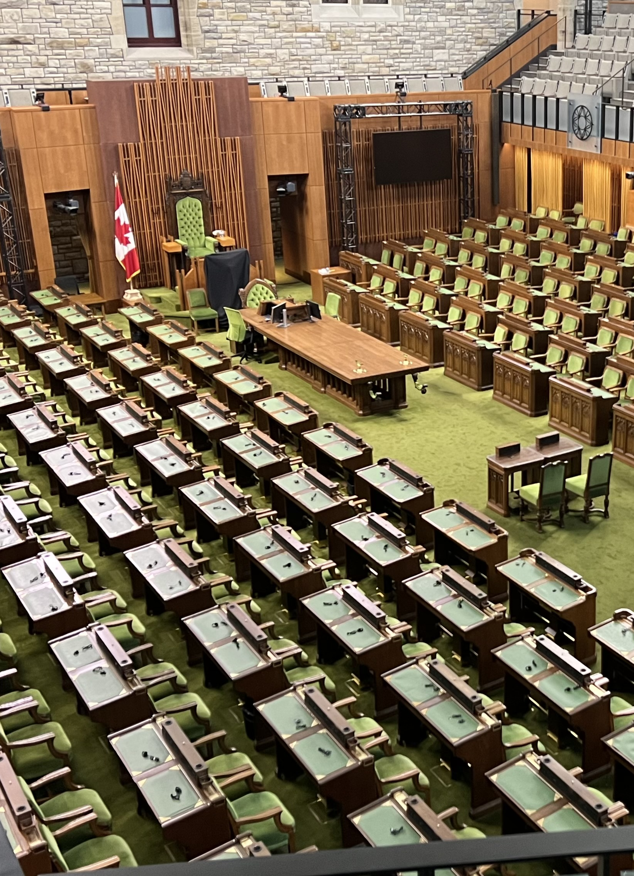
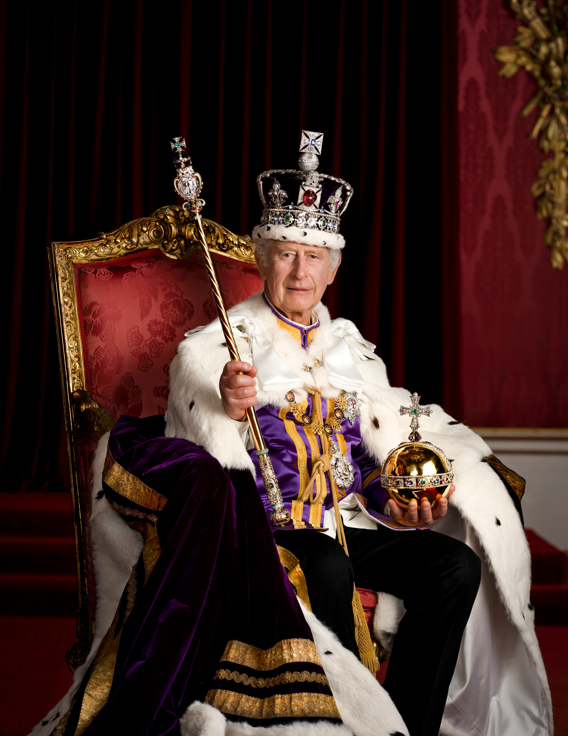
King-in-Parliament
The King of Canada
The official head of state.
Governor of Canada
the King’s representative in Canada, who gives royal assent to laws.
Senate
the appointed upper house that reviews and revises legislation.
House of Commons
the elected lower house where most legislation originates, and where the government is formed.

Slide 3
How to overthrow Canadian government?
Legally
Notes:
(Ask everyone in class): "Has anyone here ever participated in overthrowing a government?" (If someone says yes, say: "That's cool.")
"Have any of you voted in a government election?"
In a democratic state, participating in an election is like legally taking part in the process of overthrowing a government — you either vote to keep the current leadership or vote to replace it.
So, in a way, every vote is a peaceful revolution.

Slide 4
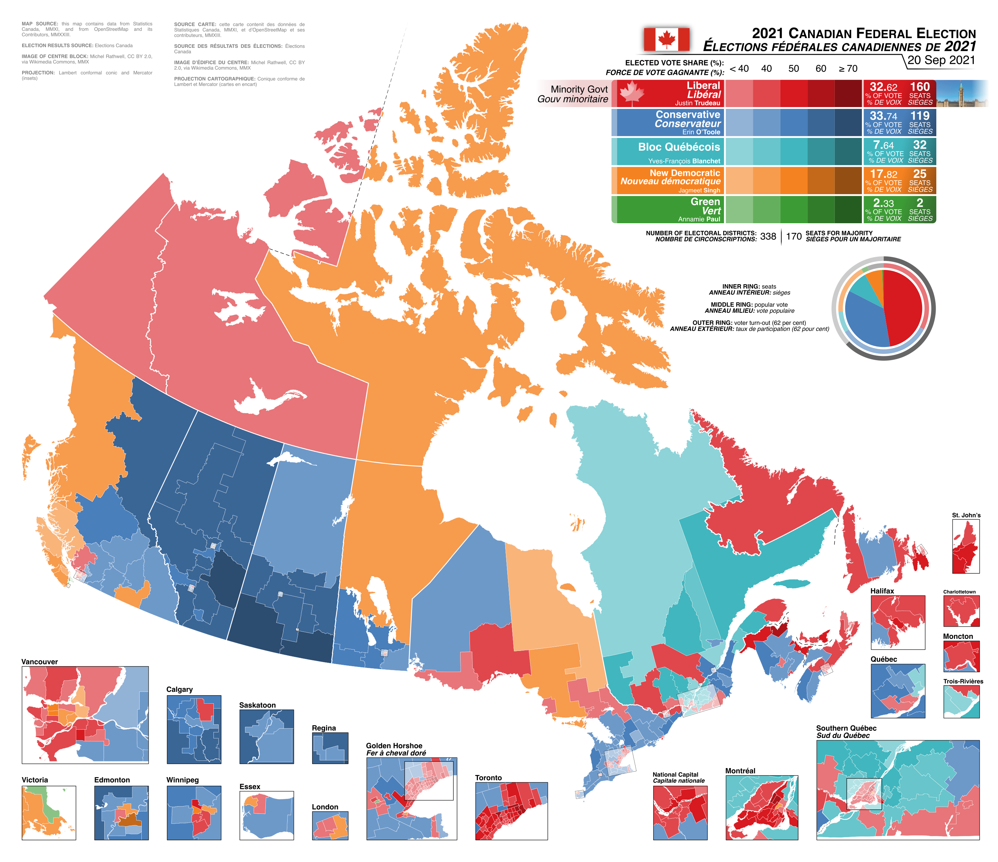
2021 federal election
Notes:
338 ridings, with 170 seats needed to win a majority government

Slide 5
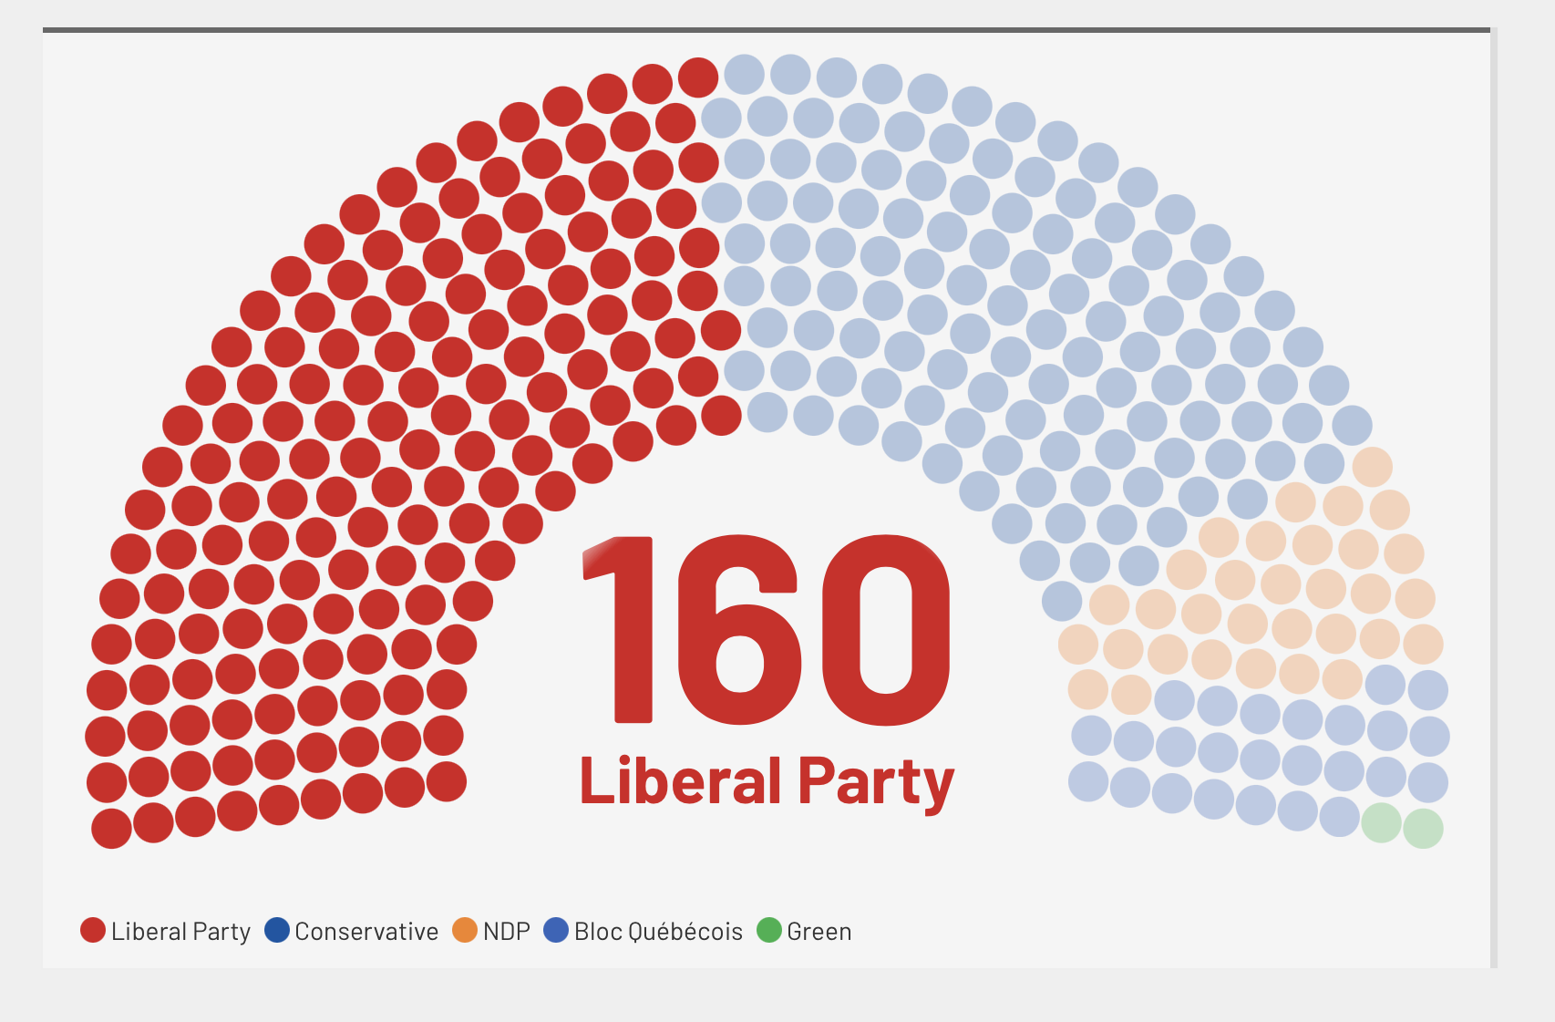

Slide 6
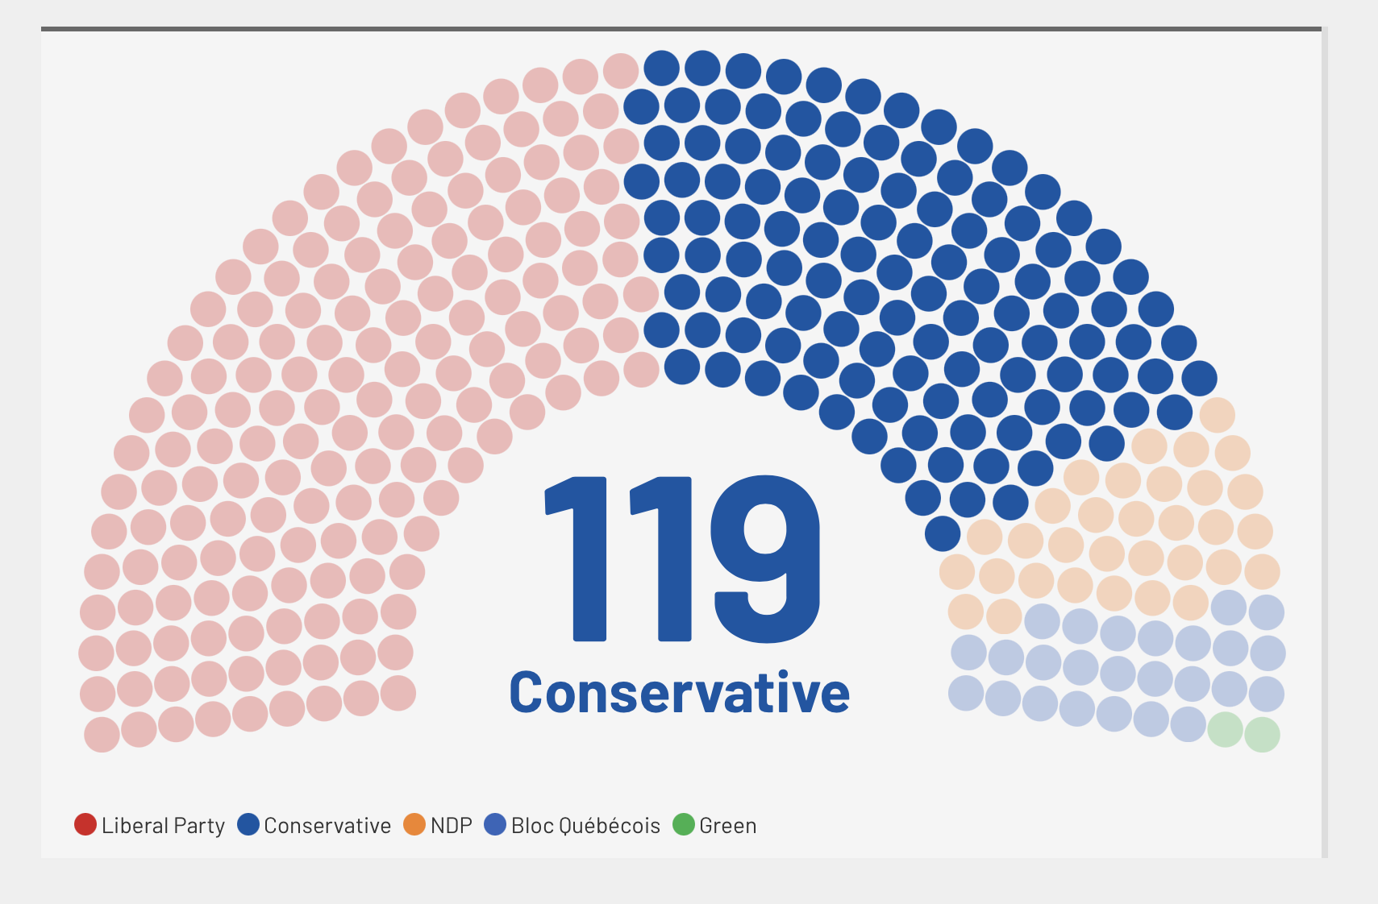

Slide 7
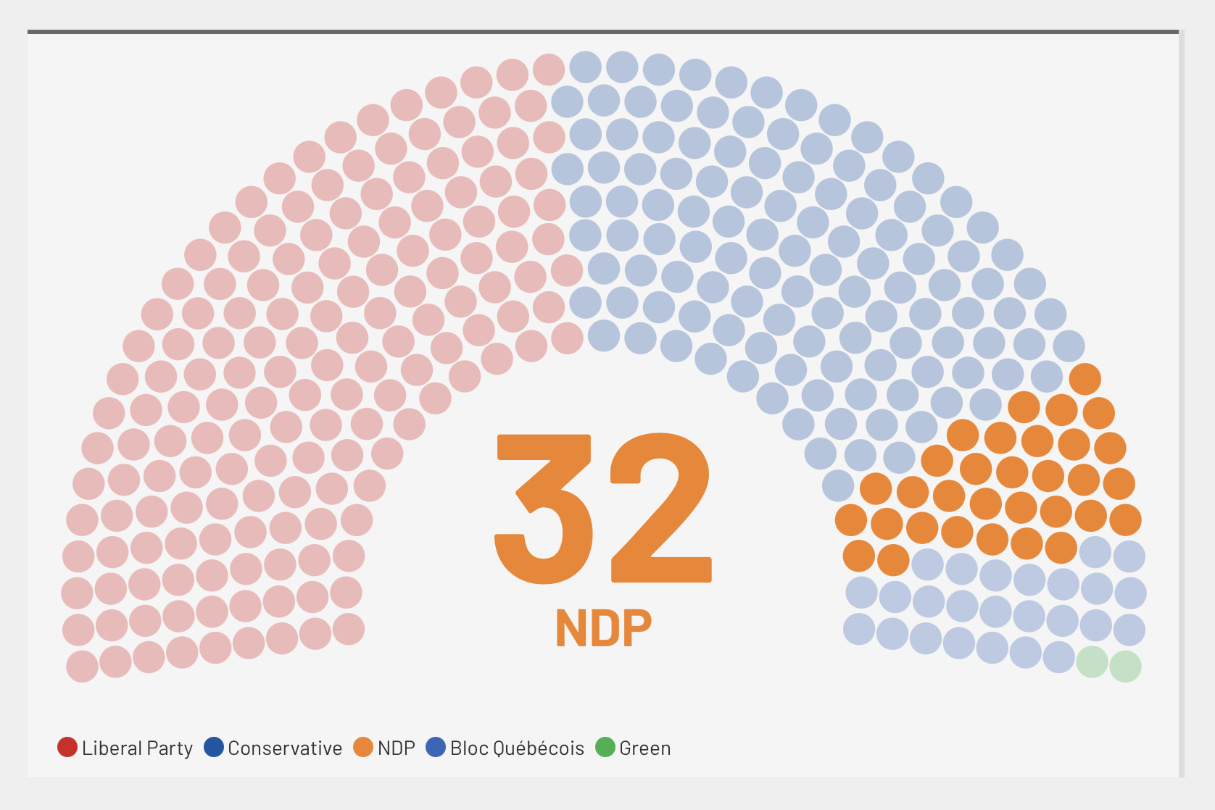

Slide 8
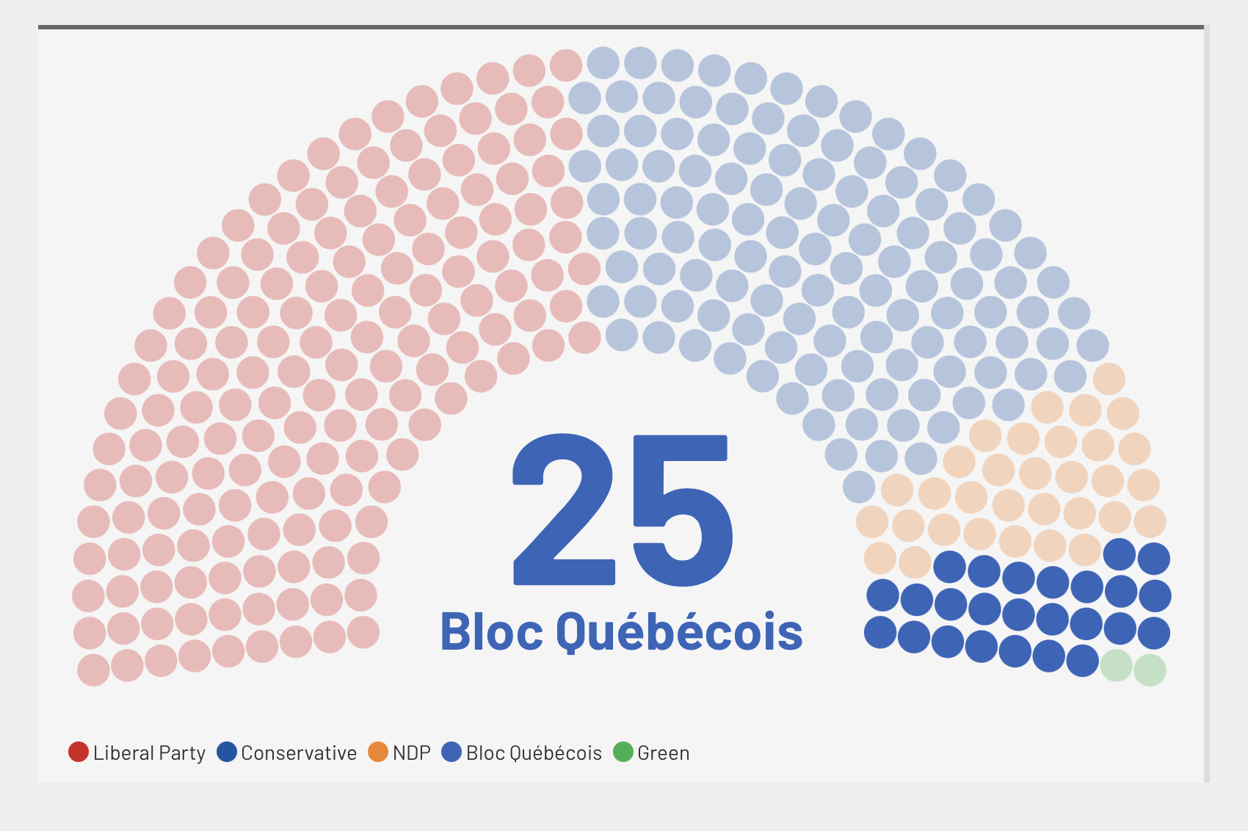

Slide 9
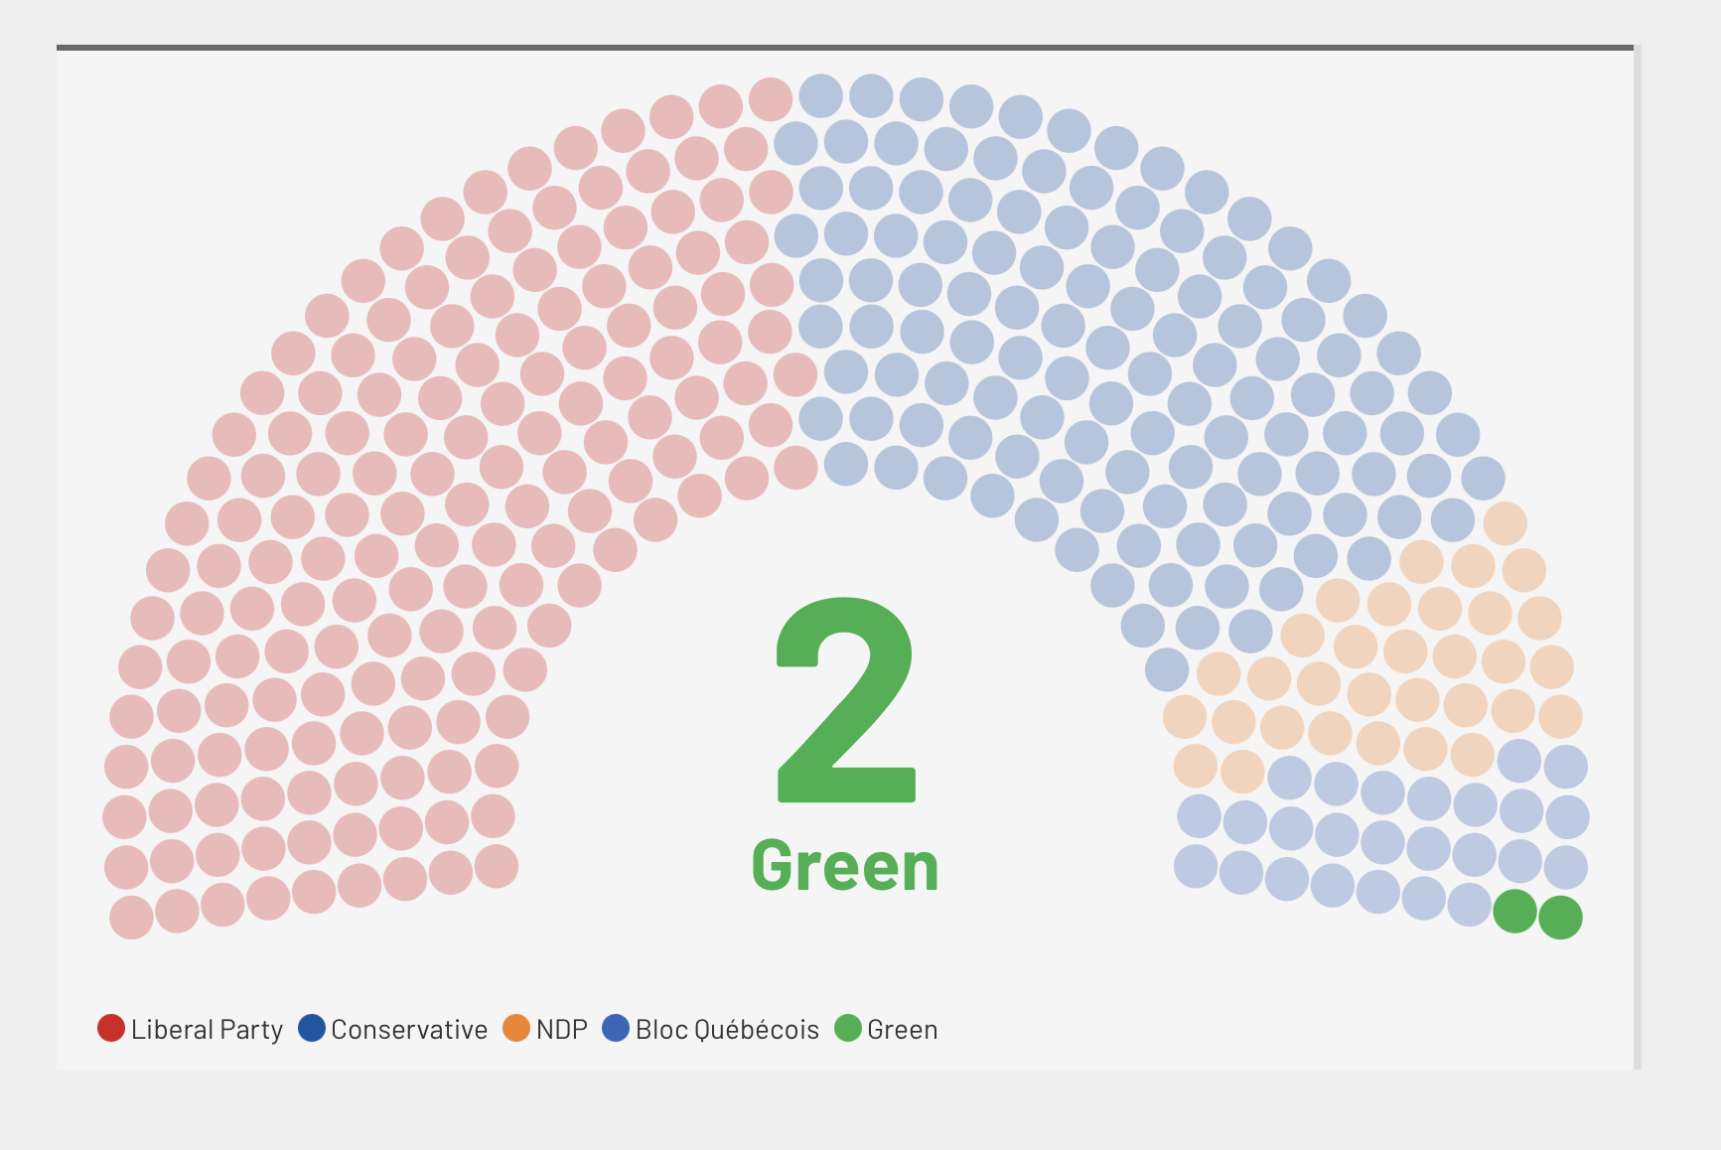

Slide 10
Question
How does the outcome of the 2021 Canadian federal election influence Winner-Loser gap in Canada?

Slide 11
Winner-loser gap or legitimacy gap
difference in political attitude and system support between those who voted for the winning party and those who voted for the losing parties.
A functional and health democracy should have small Winner-loser gap after the election.
Notes:
Think like this, if the party you performed win the election, you will feel great and if the party you vote lose the election, you may feel down.
Such difference is the Winner-loser gap.

Slide 12
Legitimacy Gap (What caused it?)
Election system
Proportional election system has less winner-loser gap compared to majoritarian system (for example: Canada) (Spina 2020)
Ideological polarization/ political parallelism
As social media and partisan media increase, voters are more likely to interpret the ideological extremity of individual party members as reflective of the ruling party‘s overall position, which reinforces perceived distance or closeness based on partisanship (Lelkes, 2016).
Experience
If the party you support often win the election with this failed will have less impact on you. (Curni, Jou and Memoli, 2011)
Quality of democracy

Slide 13
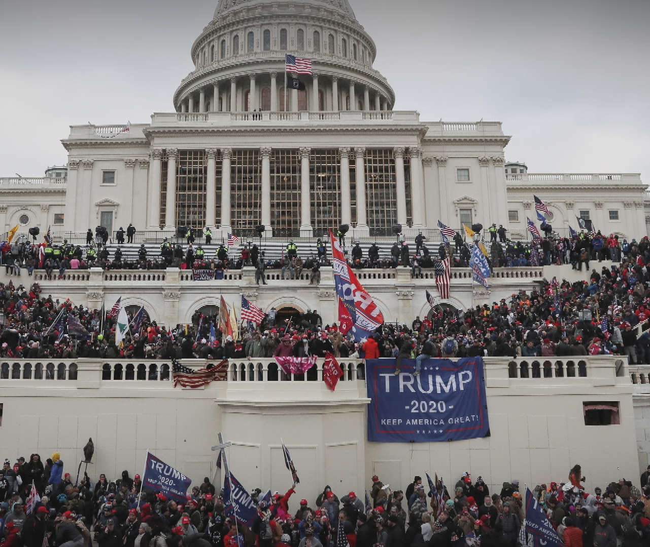
It affects democratic stability and trust in institutions.
Legitimacy Gap (Why its matter?)
Notes:
At 2020, Jan 6 where the US congress formally counts the electoral college votes for the election result.

Slide 14
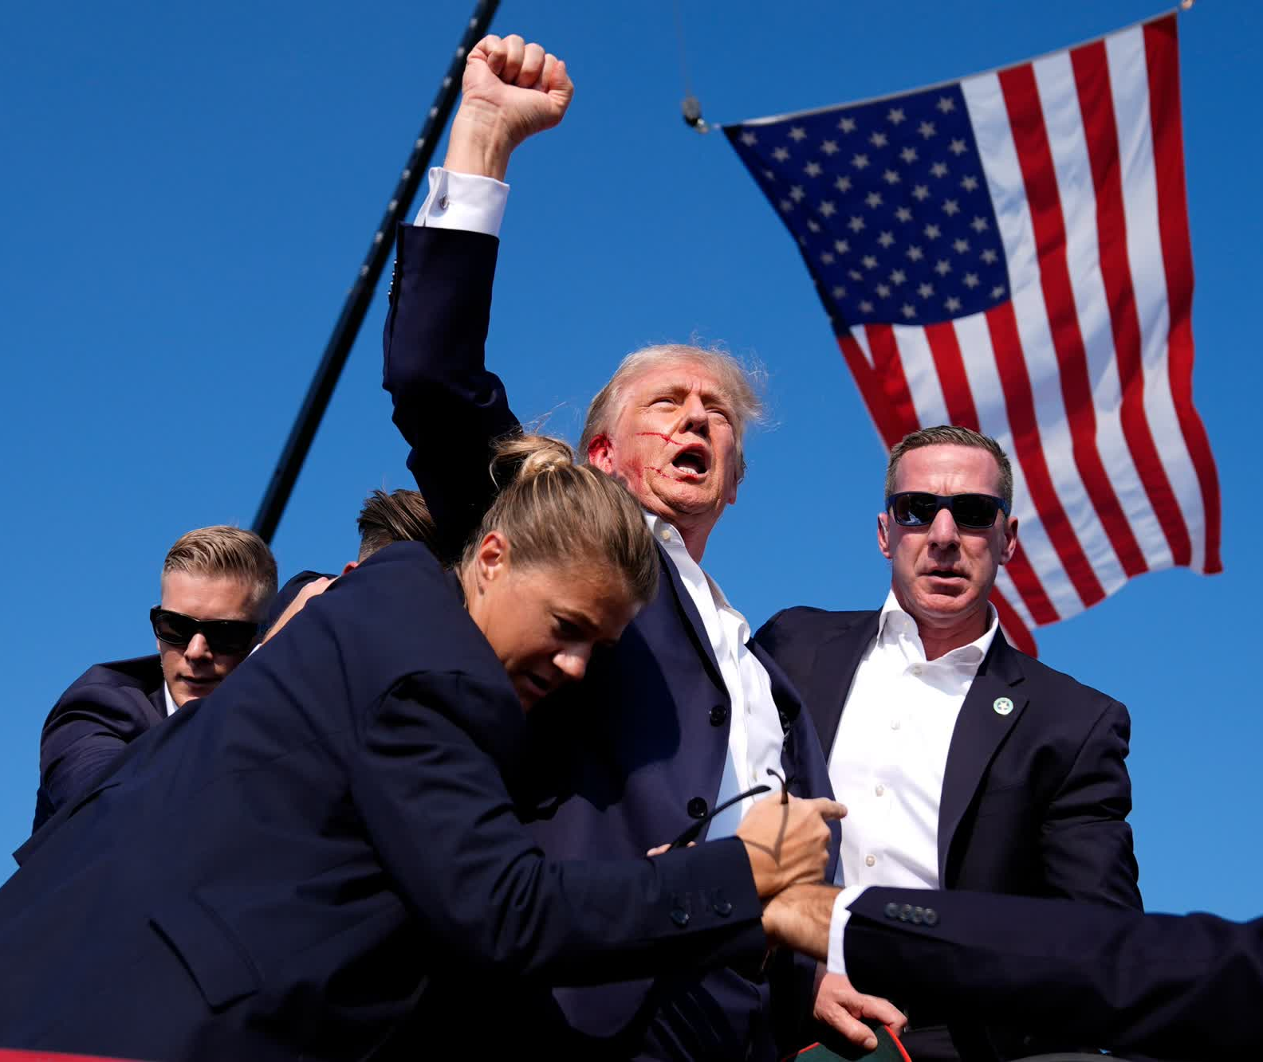
It increase political polarization and social division
Legitimacy gap (Why its matter?)

Slide 15
What make our study difference?
There is a lack of detailed studies on the Canadian winner-loser gap.
Existing models still limited to traditional statistical method
The only study we found applied ordinal logistic regression.
machine learning is cool, and We believe we are the first to apply double debiased machine learning DDML to this topic

Slide 16
What do we expect to see? (kind of literally review)
1. Winner-loser gap should exist but be moderate in size
Since Canada is a long-established democracy (with over 150 years of democratic stability), research (Farrer & Zingher, 2019; Lelkes, 2016) suggests that although electoral losers will show lower satisfaction with democracy (i.e., a winner-loser gap exists), it should be less severe than in newer or less stable democracies.
2. Overall democratic satisfaction should remain relatively high
Curini, Jou, and Memoli (2012) found that citizens in newer democracies are less satisfied overall. Since Canada is not a new democracy, we would expect higher baseline levels of democratic satisfaction — even among electoral losers, especially if the election was perceived as fair and transparent.
Notes:
Farrer and Zingher (2019) argue that while proportional representation electoral systems can mitigate dissatisfaction among electoral losers, this effect is more pronounced in countries with a longer history of democratic stability (around 40 years or more)
Lelkes (2016) also supports this idea, stating that the legitimacy gap (a concept related to the winner-loser gap) tends to be smaller in older democracies and those with more experience of fair and honest elections, compared to newer democracies or countries with higher levels of electoral corruption.
. Curini, Jou, and Memoli (2012) found that citizens in newer democracies exhibit lower levels of satisfaction with democracy compared to those in established democracies

Slide 17
Data Distribution
Our data comes from the Canadian National Elections Study (CNES) 2021.
It provides surveys conducted before and after the 2021 Canadian federal election.
Pre-election survey: August 17, 2021 – September 19, 2021
Post-election survey: September 23, 2021 – October 4, 2021
Election called: August 15, 2021
Election date: September 20, 2021
Early voting started: September 10, 2021

Slide 18
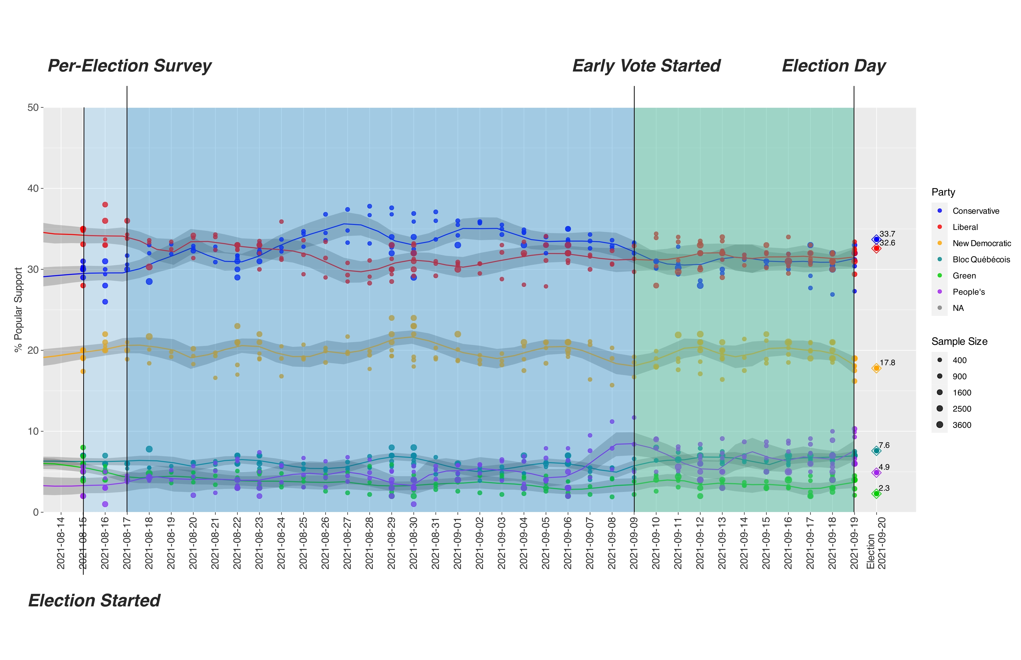

Slide 19
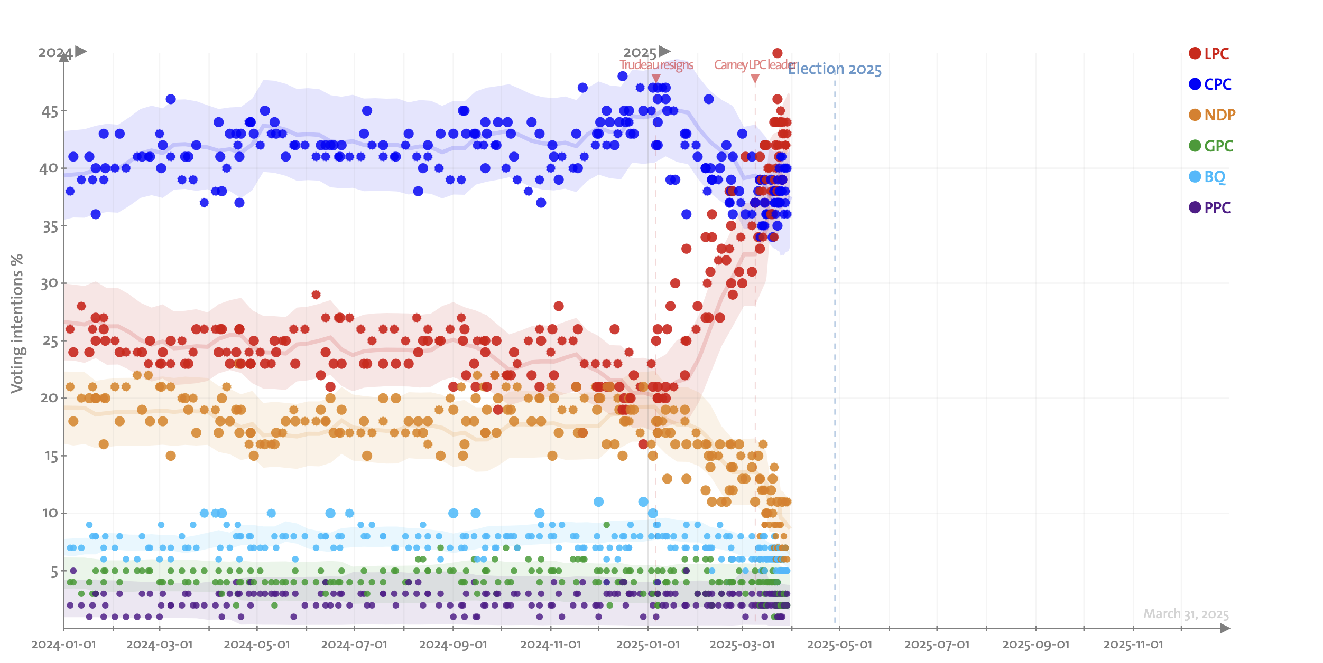
Data distraction
2025 Federal Election

Slide 20
Methodology
DDML-LASSO / Post-LASSO OLS / DDML-Random Forest
DDML-Ridge / Subgroup

Slide 21
DDML-LASSO

Slide 22
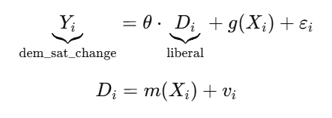
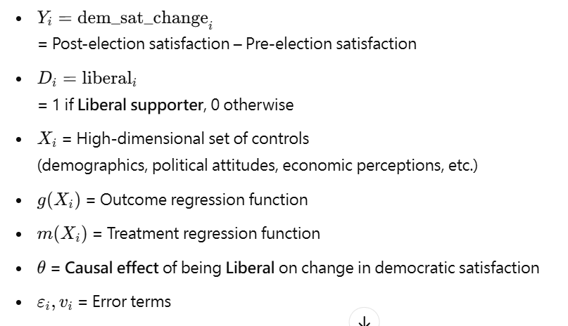
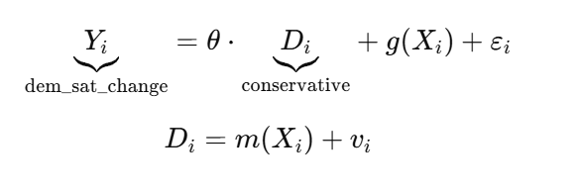
Methodology ( DDML-LASSO)

Slide 23
Control variables
DDML Model (LASSO) for Liberal
Major categories:
# Treatment & Outcome
# Demographics
# Finances & Economy
# Political Interest & Vote Intentions
# Attitudes & Satisfaction
# Group Thermometers
# Spending Preferences
# COVID-19
Total: 49 control variables

Slide 24
Confounders selected by LASSO
DDML Model (LASSO) for Liberal
[1] "(Intercept)" "UserLanguage_dummy" "cps21_bornin_canada"
[4] "cps21_children" "cps21_income_number" "cps21_vote_2019"
[7] "pes21_govtcare" "pes21_equalrights" "pes21_discfam"
[10] "cps21_spend_env" "cps21_spend_defence" "cps21_spend_imm_min"
[13] "cps21_vaccine_mandat_1"
Total: 13 confounders
(out of 39 control variables)

Slide 25
Confounders selected by LASSO
DDML Model (LASSO) for Conservative
[1] "(Intercept)" "UserLanguage_dummy" "cps21_bornin_canada"
[4] "cps21_children" "cps21_income_number" "cps21_vote_2019"
[7] "pes21_govtcare" "pes21_equalrights" "pes21_discfam"
[10] "cps21_spend_env" "cps21_spend_defence" "cps21_spend_imm_min"
[13] "cps21_vaccine_mandat_1"
Total: 13 confounders
(out of 39 control variables)

Slide 26
DDML-LASSO
Post-LASSO OLS

Slide 27
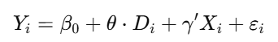
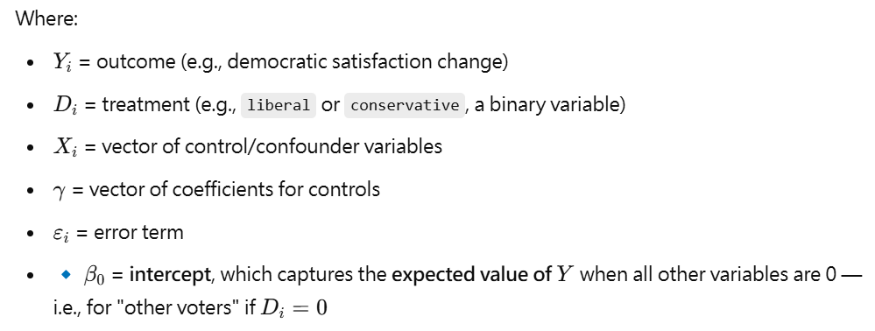
Methodology (Post-LASSO OLS)

Slide 28
DDML-LASSO
Robustness
-- Random Forest --

Slide 29
Methodology ( DDML-Random Forest)

Slide 30
DDML-LASSO
DDML-Ridge

Slide 31
Methodology ( DDML-Ridge)

Slide 32
Result – liberal
Method | Treatment | Estimate | Std. Error | t-value | p-value | Significance
DDML - Lasso | liberal | 0.18670 | 0.02835 | 6.586 | 4.51e-11 | *** (highly significant)
OLS | liberal | 0.1934 | 0.02651 | 7.297 | 3.49e-13 | *** (Highly significant)
DDML- Random Forest | liberal | 0.12092 | 0.03715 | 3.255 | 0.00114 | ** (Very significant)
DDML-Ridge | liberal | 0.19900 | 0.02791 | 7.131 | 9.97e-13 | *** (highly significant)

Slide 33
Result – Conservative
Method | Treatment | Estimate | Std. Error | t-value | p-value | Significance
DDML- Lasso | conservative | -0.15582 | 0.02866 | -5.436 | 5.44e-08 | *** (highly significant)
OLS | conservative | -0.15 | 0.02618 | -5.729 | 1.08e-08 | *** (Highly significant)
DDML-Random forest | Conservative | -0.07477 | 0.04460 | -1.676 | 0.0937 | . (< 10% significant)
DDML- Ridge | Conservative | -0.15970 | 0.02873 | -5.558 | 2.73e-08 | *** (Highly significant)

Slide 34
Robustness: Random Forest vs. OLS
DDML Model for Conservative
DDML Model (Random Forest) for
Liberal or Conservative
Is there Nonlinearity?
— Not game-changing for Liberal model.
Still finds significance
Does not reverse the effect direction
...suggests no fundamentally change the conclusion.
— Nonlinear or interaction terms not well captured for Conservative model.
Lack of significance
Does not reverse the effect direction
...suggests Nonlinearities and interactions exist — but don't flip the conclusion.

Slide 35
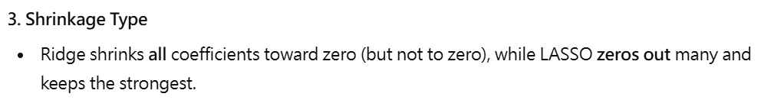
Difference between LASSO and Ridge
DDML Model for Conservative
DDML Model (Ridge) for
Liberal or Conservative
Ridge regression shrinks all coefficients (including small ones), which can reduce variance, especially when multicollinearity is strong.
Our LASSO-selected model is already stable, and Multicollinearity isn't extreme,
Then Ridge may not yield much lower SEs, even though it generally shrinks coefficients.

Slide 36
DDML-LASSO
Consider Subgroups
Income / Age / Education
Gender / Regions / Covid_sat

Slide 37
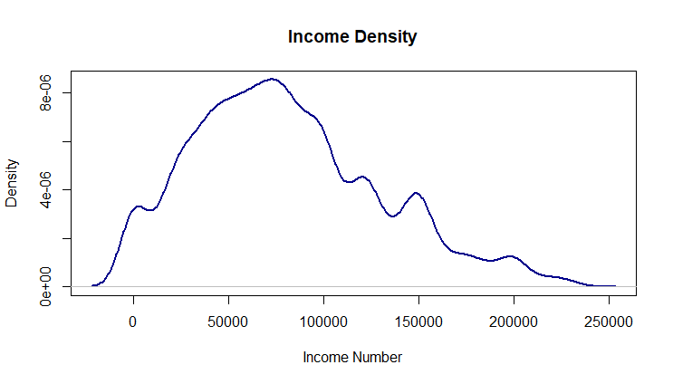
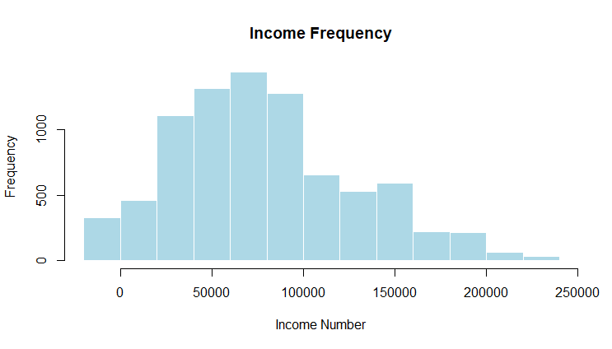
Data cleaning: Income classes
Definitions First:
Q1 = 25(lower quartile)
Q3 = 75th percentile (upper quartile)
IQR = Interquartile Range = Q3-Q1
Outlier Boundaries:
The IQR method defines outliers as any data points that are:
Too low: Less than -- Lower Bound=Q1−1.5× IQR
Too high: Greater than -- Upper Bound=Q3+1.5× IQR
Everything outside these two bounds is excluded.
Total OBS: 7779

Slide 38
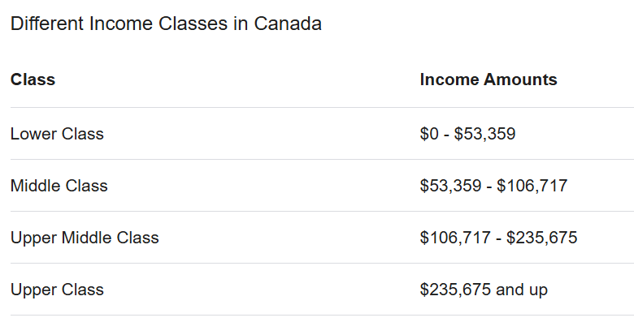
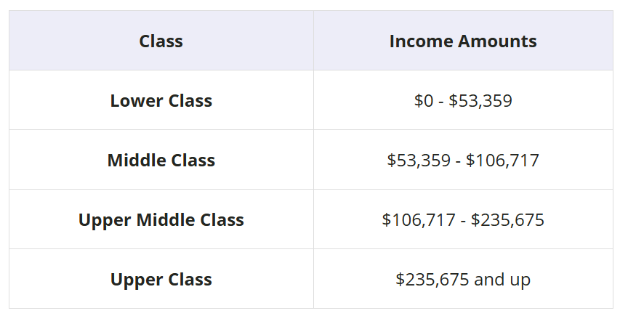
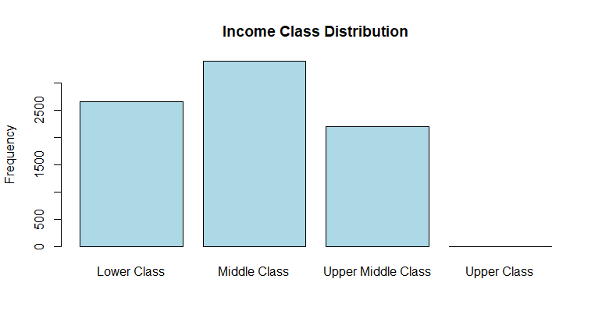
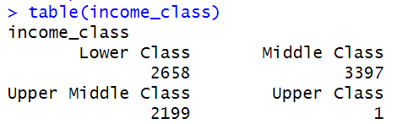
Data classification: Income classes
Source: https://www.springfinancial.ca/blog/lifestyle/middle-class-income-in-canada-by-province

Slide 39
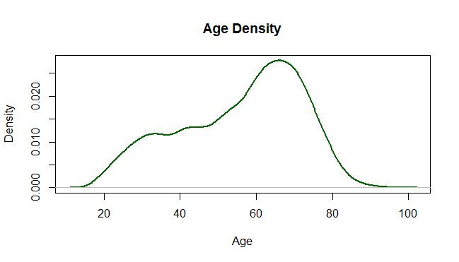
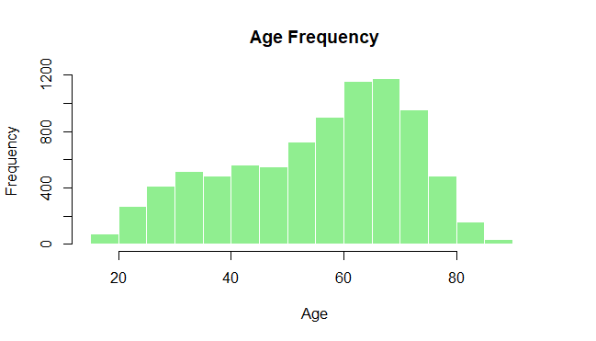
Data cleaning: Age group
Definitions First:
Q1 = 25(lower quartile)
Q3 = 75th percentile (upper quartile)
IQR = Interquartile Range = Q3-Q1
Outlier Boundaries:
The IQR method defines outliers as any data points that are:
Too low: Less than -- Lower Bound=Q1−1.5× IQR
Too high: Greater than -- Upper Bound=Q3+1.5× IQR
Everything outside these two bounds is excluded.
Total OBS: 7987

Slide 40
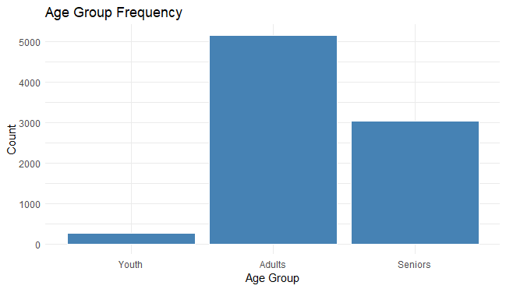
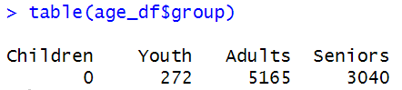
Data classification: Age group
Age group classification from Statcan:
Group | Age
Children | 00-14 years
Youth | 15-24 years
Adults | 25-64 years
Seniors | 65 years and over
Source: https://www.statcan.gc.ca/en/concepts/definitions/age2

Slide 41
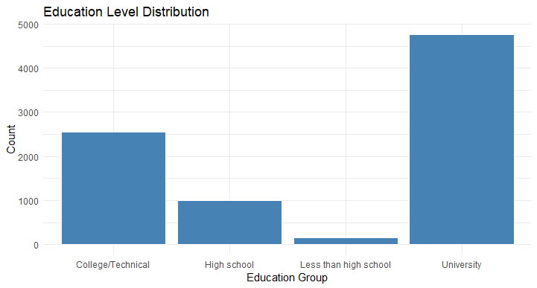
Data classification: Education group

Slide 42
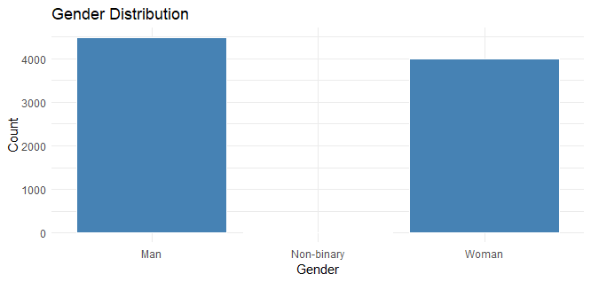
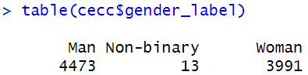
Data classification: Gender

Slide 43
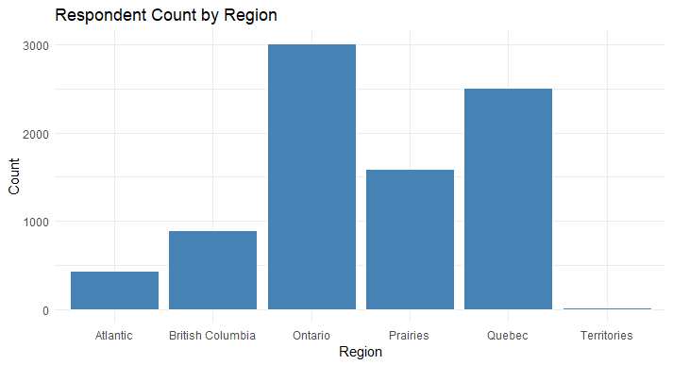
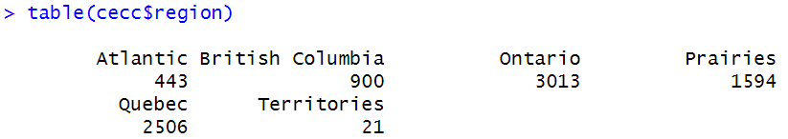
Data classification: Regions

Slide 44
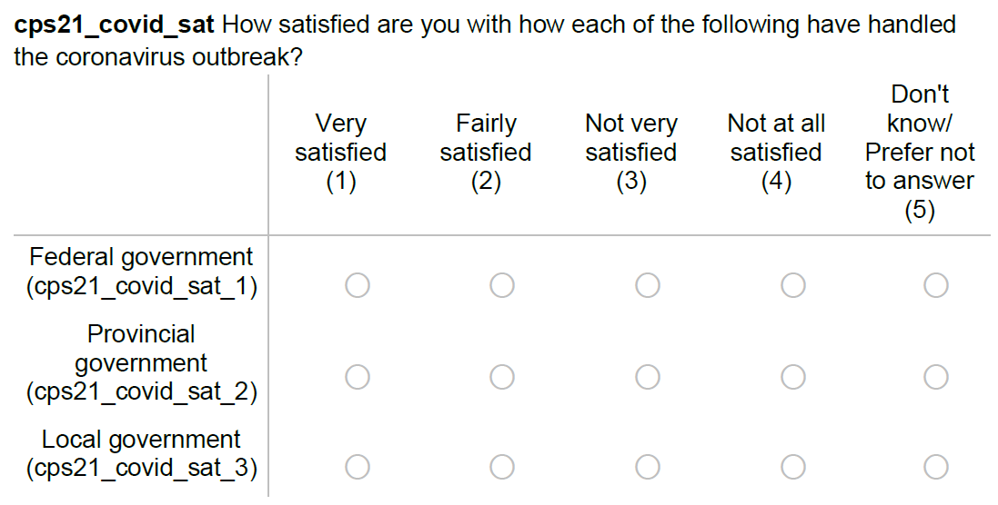
Data classification: Covid_sat
1
Total OBS: 7987
2
3

Slide 45
Consider Subgroups
DDML Model for Conservative
DDML Model (LASSO) for
Liberal or Conservative
Income---- Lower Class / Middle Class / Upper Middle Class
Age---- Youth / Adults / Seniors
Edu---- Less than High school / High school / College_Technical / University
Gender---- Man / Woman
Region--- Atlantic / BC / Quebec / Ontario / Prairies
Covid_sat--- Very / Fairly / Not Very / Not at all satisfied

Slide 46
Consider Subgroups
DDML Model for Conservative
DDML Model (LASSO) for
Liberal or Conservative
Age---- Youth
Treatmentv | Estimate | Std. Error | t-value | p-value | Significance
liberal | 0.2515 | 0.2206 | 1.14 | 0.254 | (Not significant)
conservative | 0.009521 | 0.207894 | 0.046 | 0.963 | (Not significant)
❌
❌
Age---- Adults
Treatmentv | Estimate | Std. Error | t-value | p-value | Significance
liberal | 0.18409 | 0.03424 | 5.376 | 7.61e-08 | *** (highly significant)
conservative | -0.16350 | 0.03651 | -4.479 | 7.51e-06 | *** (highly significant)
✅
✅

Slide 47
Consider Subgroups
DDML Model for Conservative
DDML Model (LASSO) for
Liberal or Conservative
Age---- Seniors
Treatmentv | Estimate | Std. Error | t-value | p-value | Significance
liberal | 0.20835 | 0.05284 | 3.943 | 8.03e-05 | *** (highly significant)
conservative | -0.17382 | 0.04701 | -3.698 | 0.000218 | *** (highly significant)
✅
✅

Slide 48
Consider Subgroups
DDML Model for Conservative
DDML Model (LASSO) for
Liberal or Conservative
Gender---- Man
Treatmentv | Estimate | Std. Error | t-value | p-value | Significance
liberal | 0.14250 | 0.04226 | 3.372 | 0.000747 | *** (highly significant)
conservative | -0.15012 | 0.03832 | -3.918 | 8.94e-05 | *** (highly significant)
✅
✅
Gender---- Woman
Treatmentv | Estimate | Std. Error | t-value | p-value | Significance
liberal | 0.22574 | 0.03827 | 5.898 | 3.68e-09 | *** (highly significant)
conservative | -0.18640 | 0.04291 | -4.344 | 1.4e-05 | *** (highly significant)
✅
✅

Slide 49
Consider Subgroups
DDML Model for Conservative
DDML Model (LASSO) for
Liberal or Conservative
Income---- Lower Class
Treatmentv | Estimate | Std. Error | t-value | p-value | Significance
liberal | 0.23739 | 0.05777 | 4.109 | 3.97e-05 | *** (highly significant)
conservative | -0.17697 | 0.05358 | -3.303 | 0.000957 | *** (highly significant)
✅
✅
Income---- Middle Class
Treatmentv | Estimate | Std. Error | t-value | p-value | Significance
liberal | 0.16710 | 0.04269 | 3.915 | 9.06e-05 | *** (highly significant)
conservative | -0.18192 | 0.04319 | -4.213 | 2.52e-05 | *** (highly significant)
✅
✅

Slide 50
Consider Subgroups
DDML Model for Conservative
DDML Model (LASSO) for
Liberal or Conservative
Income---- Upper Middle Class
Treatmentv | Estimate | Std. Error | t-value | p-value | Significance
liberal | 0.18273 | 0.04594 | 3.977 | 6.97e-05 | *** (highly significant)
conservative | -0.10948 | 0.05342 | -2.05 | 0.0404 | * (< 5% significant)
✅
✅

Slide 51
Consider Subgroups
DDML Model for Conservative
DDML Model (LASSO) for
Liberal or Conservative
Region--- Atlantic
Treatmentv | Estimate | Std. Error | t-value | p-value | Significance
liberal | 0.18133 | 0.08885 | 2.041 | 0.0413 | * (< 5% significant)
conservative | -0.08132 | 0.11325 | -0.718 | 0.473 | (Not significant)
✅
❌
Region--- British Columbia
Treatmentv | Estimate | Std. Error | t-value | p-value | Significance
liberal | 0.06497 | 0.08471 | 0.767 | 0.443 | (Not significant)
conservative | -0.01181 | 0.08480 | -0.139 | 0.889 | (Not significant)
❌
❌

Slide 52
Consider Subgroups
DDML Model for Conservative
DDML Model (LASSO) for
Liberal or Conservative
Region--- Ontario
Treatmentv | Estimate | Std. Error | t-value | p-value | Significance
liberal | 0.21747 | 0.04475 | 4.86 | 1.17e-06 | *** (highly significant)
conservative | -0.20272 | 0.04376 | -4.632 | 3.62e-06 | *** (highly significant)
✅
✅
Region--- Quebec
Treatmentv | Estimate | Std. Error | t-value | p-value | Significance
liberal | 0.14161 | 0.05721 | 2.475 | 0.0133 | * (< 5% significant)
conservative | -0.06320 | 0.06116 | -1.033 | 0.301 | (Not significant)
✅
❌

Slide 53
Consider Subgroups
DDML Model for Conservative
DDML Model (LASSO) for
Liberal or Conservative
Region--- Prairies
Treatmentv | Estimate | Std. Error | t-value | p-value | Significance
liberal | 0.27732 | 0.06422 | 4.319 | 1.57e-05 | *** (highly significant)
conservative | -0.21954 | 0.06117 | -3.589 | 0.000332 | *** (highly significant)
✅
✅

Slide 54
Consider Subgroups
DDML Model for Conservative
DDML Model (LASSO) for
Liberal or Conservative
Edu---- Less than High school
Treatmentv | Estimate | Std. Error | t-value | p-value | Significance
liberal | 0.05956 | 0.39034 | 0.153 | 0.879 | (Not significant)
conservative | -0.1494 | 0.1769 | -0.844 | 0.398 | (Not significant)
❌
❌
Edu---- High school
Treatmentv | Estimate | Std. Error | t-value | p-value | Significance
liberal | 0.3198 | 0.1067 | 2.997 | 0.00273 | ** (Very significant)
conservative | -0.22423 | 0.08289 | -2.705 | 0.00682 | ** (Very significant)
✅
✅

Slide 55
Consider Subgroups
DDML Model for Conservative
DDML Model (LASSO) for
Liberal or Conservative
Edu---- College_Technical
Treatmentv | Estimate | Std. Error | t-value | p-value | Significance
liberal | 0.22293 | 0.05901 | 3.778 | 0.000158 | *** (highly significant)
conservative | -0.15635 | 0.05404 | -2.893 | 0.00381 | ** (Very significant)
✅
✅
Edu---- University
Treatmentv | Estimate | Std. Error | t-value | p-value | Significance
liberal | 0.19448 | 0.03299 | 5.895 | 3.74e-09 | *** (highly significant)
conservative | -0.14832 | 0.03792 | -3.911 | 9.18e-05 | *** (highly significant)
✅
✅

Slide 56
Consider Subgroups
DDML Model for Conservative
DDML Model (LASSO) for
Liberal or Conservative
Covid_sat--- Very satisfied
Treatmentv | Estimate | Std. Error | t-value | p-value | Significance
liberal | 0.3827 | 0.2010 | 1.904 | 0.0569 | . (< 10% significant)
conservative | -0.1288 | 0.0803 | -1.604 | 0.109 | (Not significant)
✅
❌
Covid_sat--- Fairly satisfied
Treatmentv | Estimate | Std. Error | t-value | p-value | Significance
liberal | 0.16663 | 0.06664 | 2.5 | 0.0124 | * (< 5% significant)
conservative | -0.14870 | 0.05824 | -2.553 | 0.0107 | * (< 5% significant)
✅
✅

Slide 57
Consider Subgroups
DDML Model for Conservative
DDML Model (LASSO) for
Liberal or Conservative
Covid_sat--- Not Very satisfied
Treatmentv | Estimate | Std. Error | t-value | p-value | Significance
liberal | 0.12847 | 0.03389 | 3.79 | 0.00015 | *** (highly significant)
conservative | -0.07924 | 0.04747 | -1.669 | 0.0951 | . (< 10% significant)
✅
✅
Covid_sat--- Not at all satisfied
Treatmentv | Estimate | Std. Error | t-value | p-value | Significance
liberal | 0.19537 | 0.07729 | 2.528 | 0.0115 | * (< 5% significant)
conservative | -0.3279 | 0.0950 | -3.452 | 0.000557 | *** (highly significant)
✅
✅

Slide 58
Consider Subgroups
DDML Model for Conservative
DDML Model (LASSO) for
Liberal or Conservative
Income---- Lower Class / Middle Class / Upper Middle Class
Age---- Adults / Seniors
Edu---- High school / College_Technical / University
Gender---- Man / Woman
Region--- Ontario / Prairies
Covid_sat--- Fairly / Not Very / Not at all satisfied
These remaining subgroups are where our treatment effects hold up the best — and they help tell the clearest story.

Slide 59
Summary
DDML Model for Conservative
“In short, data may be messy, but method matters — and DDML helps bring clarity to complexity”

Slide 60
Conclusion
DDML Model for Conservative
For now, our results suggest that our study aligns with the empirical literature. Although a winner–loser gap exists, it is relatively small, as people continue to trust in the democratic process.
If we have enough time, we could expand this project to include different years in order to capture time series trends, which would provide important insights for policymakers and political scientists.

Slide 61
Reference
DDML Model for Conservative
Blais, André, and François Gélineau. “Winning, Losing and Satisfaction with Democracy.” Political Studies 55, no. 2 (2007): 425–441. https://doi.org/10.1111/j.1467-9248.2007.00659.x.
. Blais, André, and Marc André Bodet. “How Do Voters Form Expectations about the Parties’ Chances of Winning the Election?” Social Science Quarterly 87, no. 3 (2006): 477–493. https://www.jstor.org/stable/42956137.
Curini, Luigi, Willy Jou, and Vincenzo Memoli. “Satisfaction with Democracy and the Winner–Loser Debate: The Role of Policy Preferences and Past Experience.” British Journal of Political Science 42, no. 2 (2012): 241–261. https://www.jstor.org/stable/41485683.
Daoust, Jean-François, Miroslav Nemčok, Philipp Broniecki, and Peter J. Loewen. “Reassessing the Winner–Loser Gap in Satisfaction with Democracy.” PLOS ONE 19, no. 12 (2024): e0314967. https://doi.org/10.1371/journal.pone.0314967.
Esaiasson, Peter. “Electoral Losers Revisited – How Citizens React to Defeat at the Ballot Box.” Electoral Studies 30, no. 1 (2011): 102–113. https://doi.org/10.1016/j.electstud.2010.09.009.

Slide 62
Reference
DDML Model for Conservative
Farrer, Benjamin, and Joshua N. Zingher. “A Global Analysis of How Losing an Election Affects Voter Satisfaction with Democracy.” International Political Science Review 40, no. 4 (2019): 518–534. https://www.jstor.org/stable/10.2307/26956805.
Janssen, Lisa. “Sweet Victory, Bitter Defeat: The Amplifying Effects of Affective and Perceived Ideological Polarization on the Winner–Loser Gap in Political Support.” European Journal of Political Research 63, no. 2 (2024): 455–477. https://doi.org/10.1111/1475-6765.12625.
Monsiváis-Carrillo, Alejandro. “Permissive Winners? The Quality of Democracy and the Winner–Loser Gap in the Perception of Freedoms.” Political Studies 70, no. 1 (2022): 173–194.
https://doi.org/10.1177/0032321720952230.
Spina, Nicholas. “Partisanship and Generalized Trust in Response to the 2016 U.S. Presidential Election.” The Social Science Journal 62, no. 1 (2025): 123–135. https://doi.org/10.1080/03623319.2021.1899361.

Slide 63
Reference
DDML Model for Conservative
Burnand, Hugo. “King Charles and Queen Camilla Pose for Coronation Portrait.” The New York Times, May 8, 2023. https://www.nytimes.com/2023/05/08/arts/design/king-charles-coronation-portrait-hugo-burnand.html.
Fournier, Philippe J. "Canada Polls." 338Canada. Accessed March 31, 2025. https://338canada.com/polls.htm.
Elections Canada. "Map of Official Results for the 44th General Election (2021)." Accessed March 31, 2025. https://www.elections.ca/res/cir/maps2/map.asp?map=ERMap_44&lang=e.
Taddonio, Patrice. "Jan. 6, Three Years Later: 10 Documentaries to Watch." Frontline, January 5, 2024. https://www.pbs.org/wgbh/frontline/article/january-6-insurrection-capitol-attack-documentaries-streaming/
Almond, Kyle. "How Photographers Captured the Trump Assassination Attempt." CNN, July 15, 2024. https://www.cnn.com/interactive/2024/07/politics/photographers-trump-shooting-cnnphotos/.

